Slide 1

Naruhodo!
A laboratory on your desk!
Designed & developed by Bowei Zhou

Slide 2
Outline
What is Naruhodo?
What can we do?
How does it work?

Slide 3
What is Naruhodo?

Slide 4

Inequality of education opportunity
The inequality of education opportunity is a serious problem. It is necessary for a government to give everyone a quality education.

Slide 5
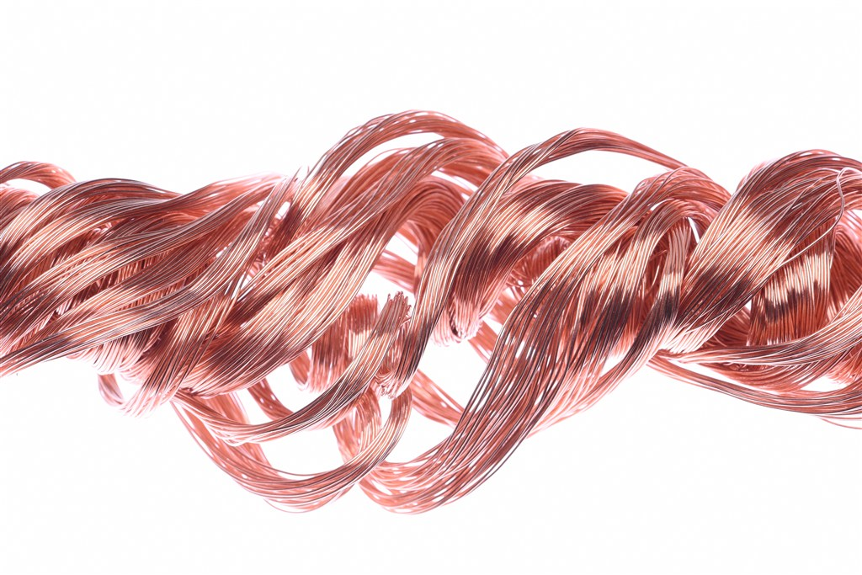
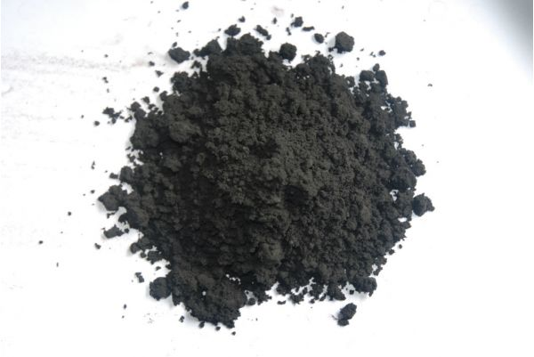

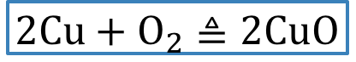
A true story about me
In my school days, I enjoyed doing experiments at home…
$$2Cu+O_{2}≜2CuO$$
Notes:
In my school days, I enjoyed doing experiments at home…Like this

Slide 6

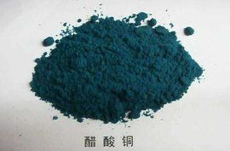
A true story about me
In my school days, I enjoyed doing experiments at home…
$$CuO+{2CH}_{3}COOH=H_{2}O+Cu{({CH}_{3}COO)}_{2}$$
Notes:
And this

Slide 7
What is Naruhodo?
Naruhodo is a Japanese word,
which means
“I see!” or “A-ha!”
It is necessary to do experiments by oneself, in order to improve scientific literacy.
Notes:
After the experiments, I may say “naruhodo”, which means “I see” or “Aha” in Japanese.
I think that in order to improve scientific literacy, it is necessary to do experiments by oneself.
In other word, we need to practice more, to say more “naruhodo”

Slide 8
What can we do?

Slide 9

I want to do experiments at home!
Let AR technology help you.
Notes:
Of course my experiments are very simple.
But other experiments might be dangerous or maybe we don’t have enough equipment.
Then the AR technology will help us.

Slide 10
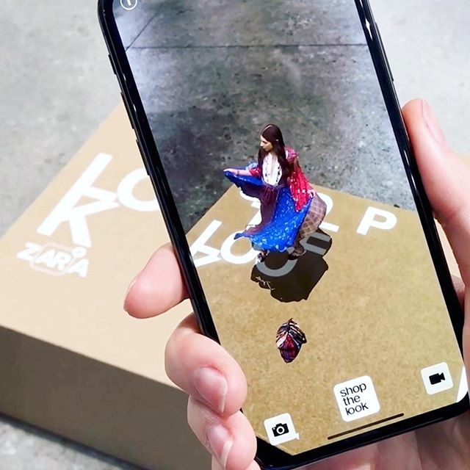
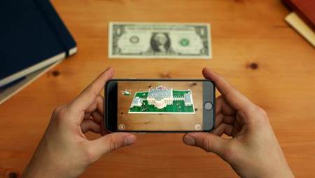
AR (Augmented Reality) technology
AR is a technology that allows the virtual world on the screen to combine and interact with real-world scenes.

Slide 11
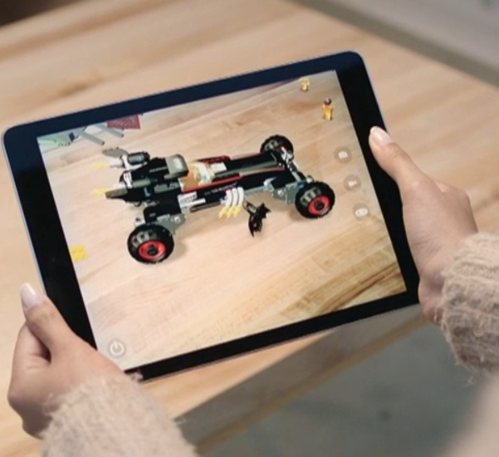
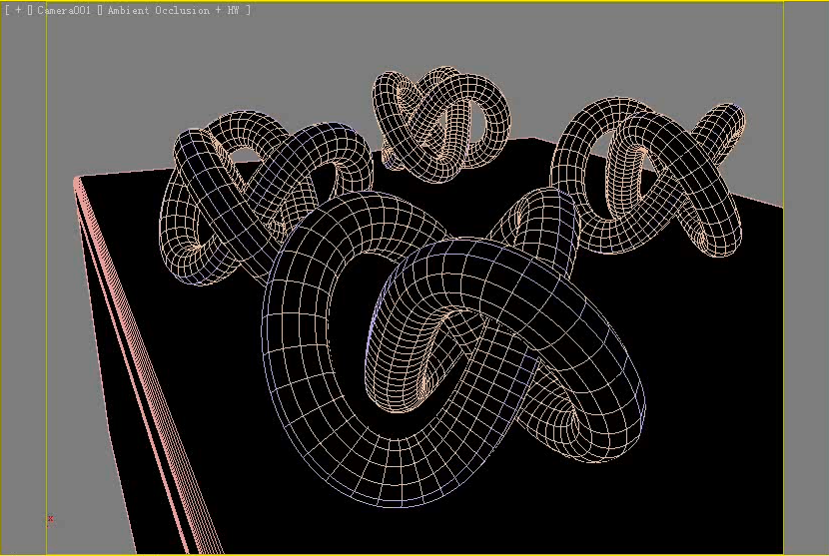
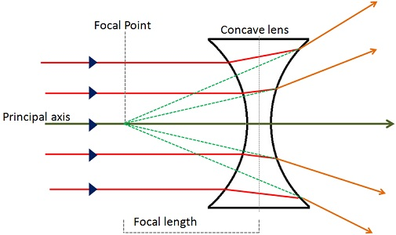
Naruhodo
=
AR + Physics + 3D

Slide 12
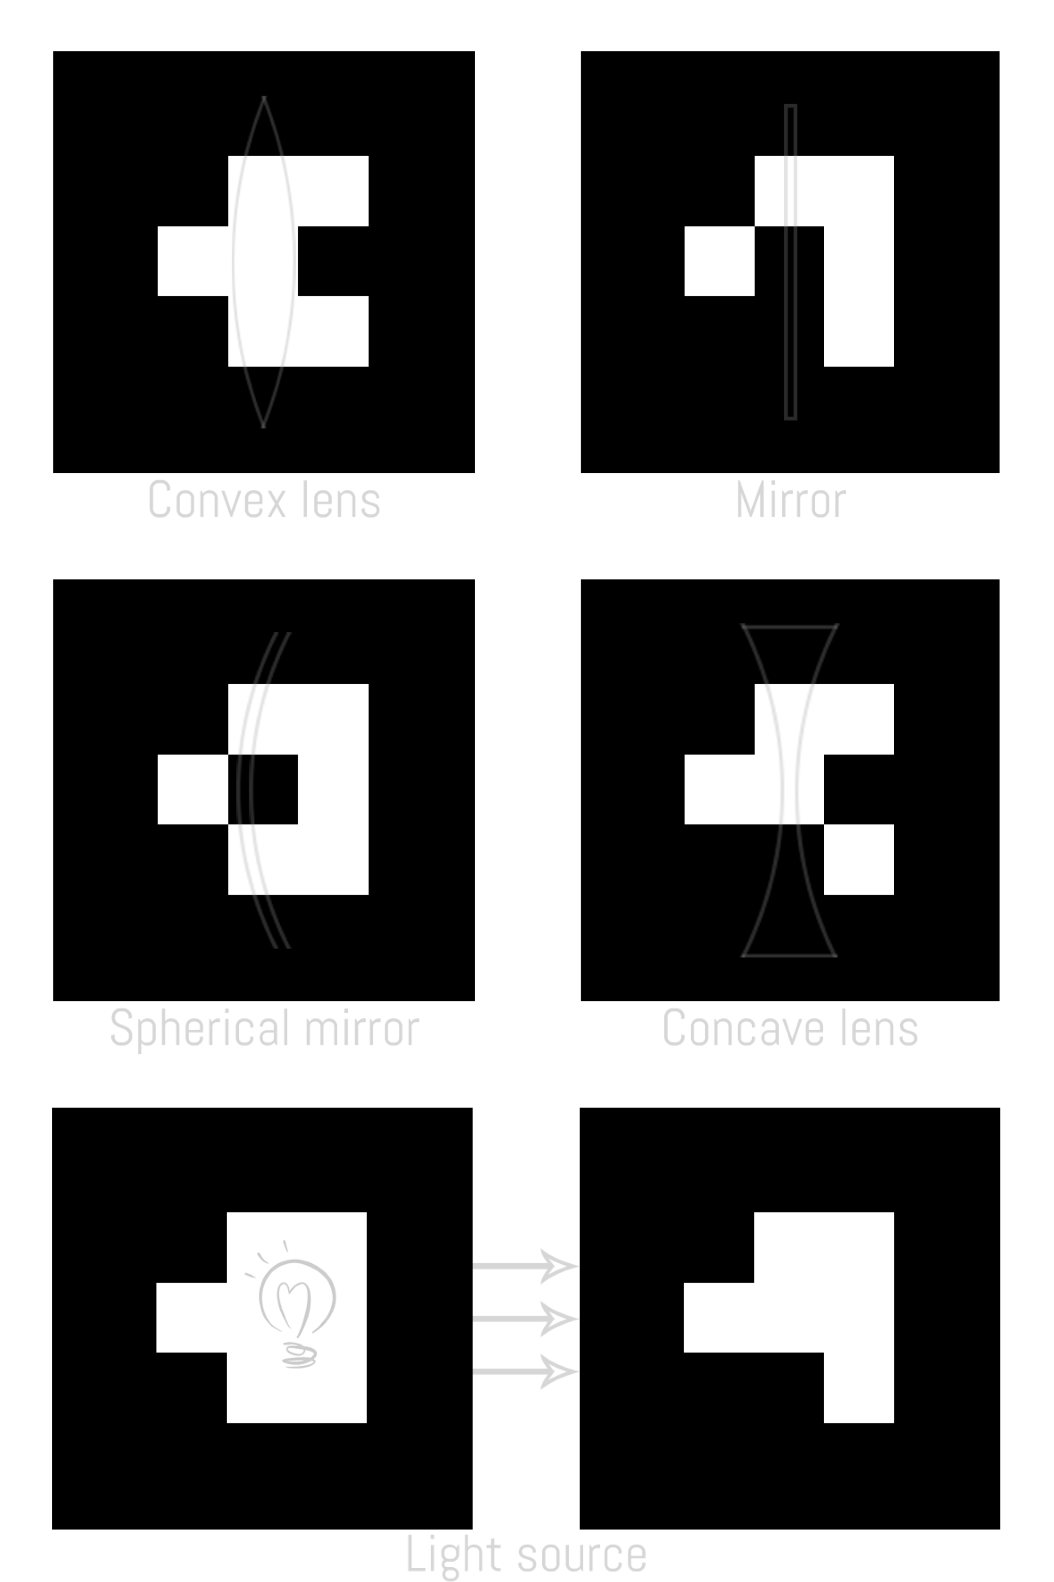
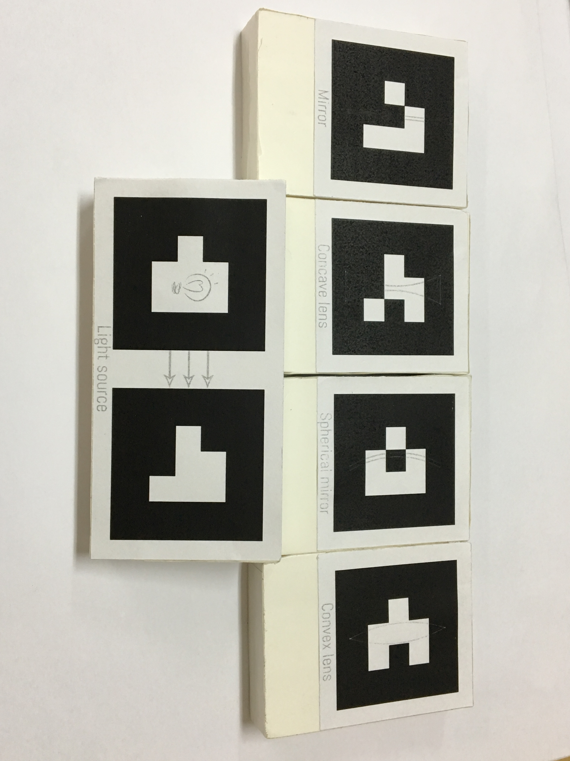
Print the markers
Notes:
When you are deciding to use naruhodo, you should first print the markers like this.

Slide 13
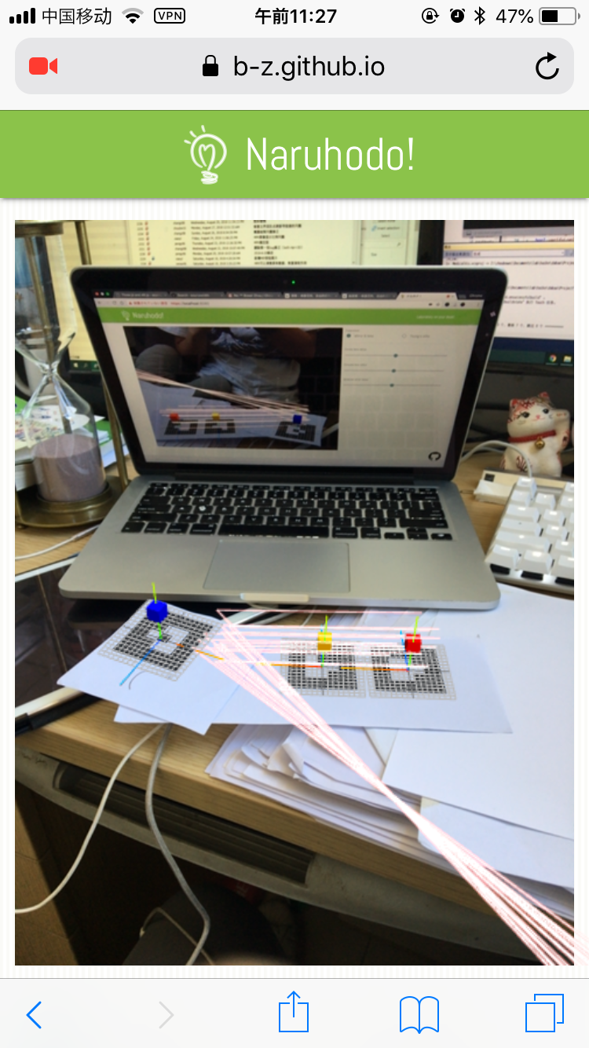
Place the markers on your desk
Notes:
And then, place the markers on your desk, and observe them through naruhodo’s interface.
Currently, naruhodo provides an optical experiment (光学实验 こうがく じっけん). And here is the video demonstration

Slide 14
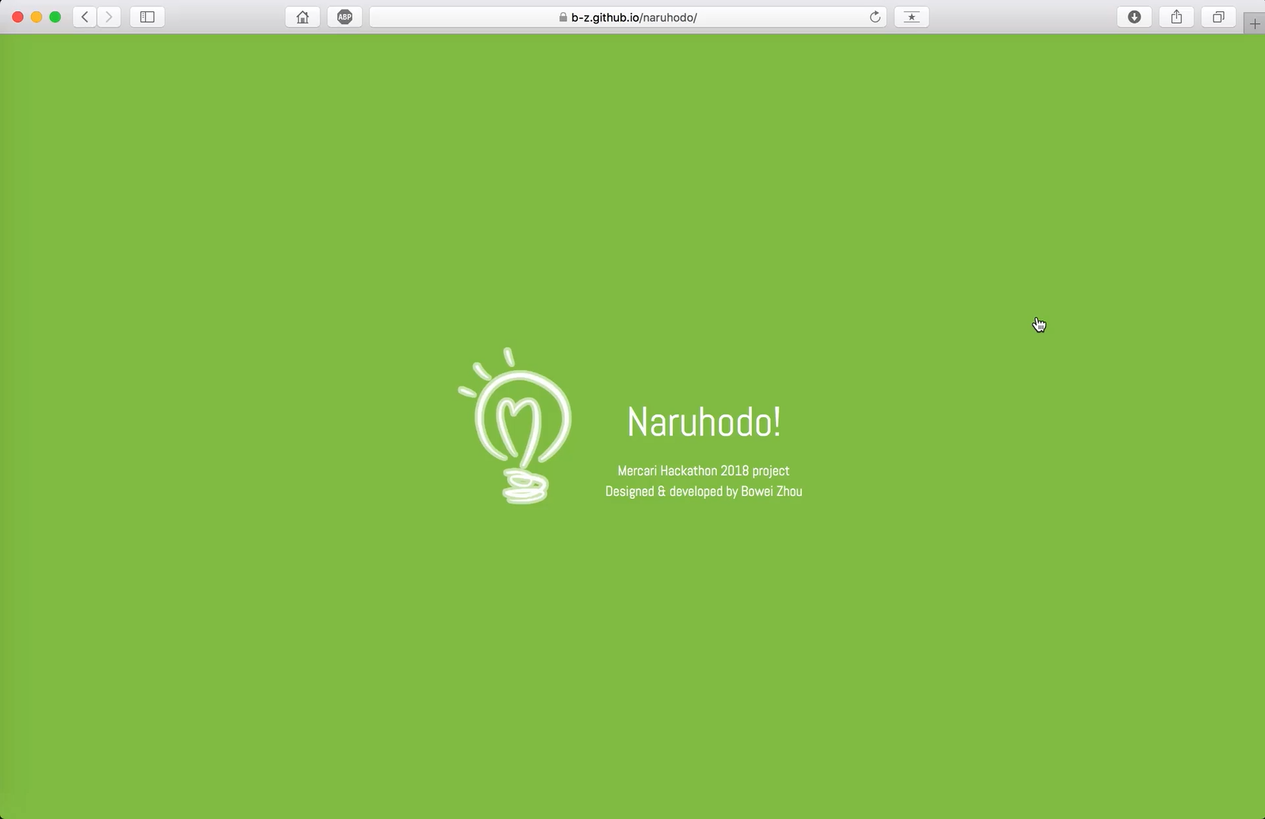

Slide 15
How does it work?

Slide 16
System structure
Visualization
3D Renderer
View
( front-end )
WebGL
Layer-3
Objects
Physical Simulation
Layer-2
Spatial locations
Video
AR
ARToolKit
Layer-1
Notes:
The grey and the blue parts are my works.

Slide 17
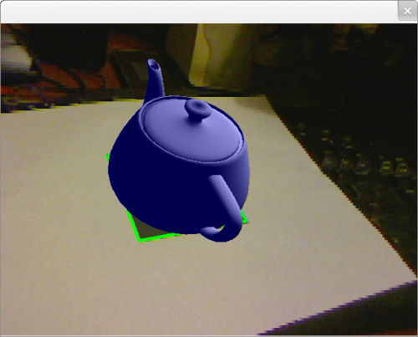
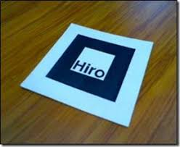

Layer-3: AR
Core:
Video + ARToolKit → 3D Position and orientations of the markers

Slide 18
Layer-3: AR
Need to balance the height and orientation of the markers
orientation
height

Slide 19
Layer-3: AR
Balance the orientations:
Calculate the world coordinate of (0, 1, 0) vector in each marker’s world.
Calculate the mean orientation.
Rotate the markers’ worlds.
Balance the heights:
Solve the inverse matrix of a matrix formed by orthogonal vectors of respective marker’s world.
Use matrix multiplication to get the spatial height of each marker.
Balance their heights.

Slide 20
Layer-3: AR
Notes:
Although I speak very quickly due to the time limit, it is really difficult here.
You know, there are a lot of potential work, more than a thousand lines of code in total.
And most of the code are math calculations..

Slide 21
Layer-2: Physical simulation
Physical simulation
Refraction and reflection
Test intersections with
Sphere
Plane
Physical Simulation
Layer-2
Balanced positions and orientations
AR
Layer-1
ARToolKit

Slide 22
Layer-2: Physical simulation
Notes:
There are many difficult 3D vector and matrix calculations.

Slide 23
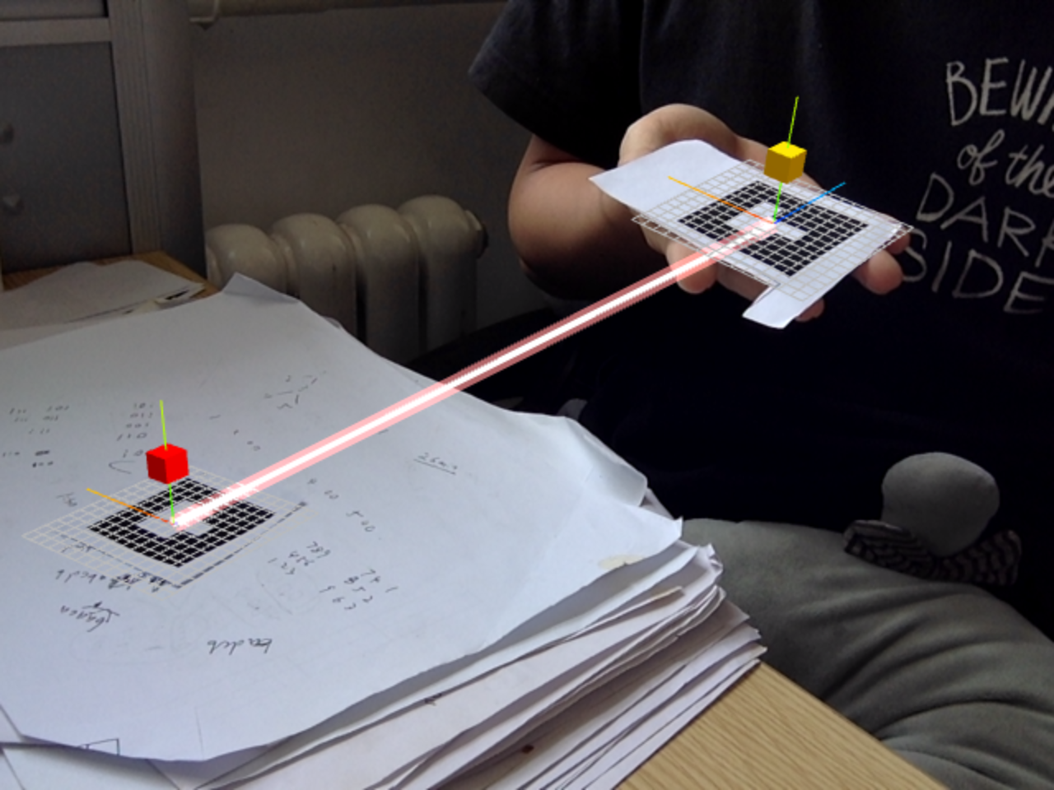
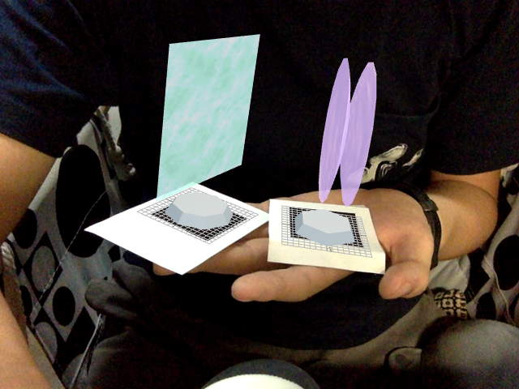
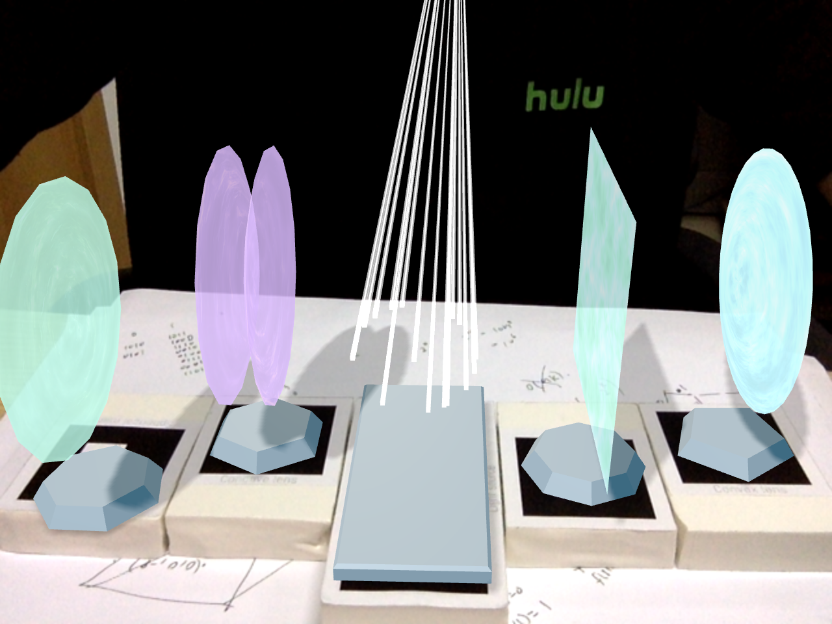
Layer-1: 3D renderer
In Layer-1, I should:
Design & draw the objects
Design the material of the objects
Add some light sources
Draw the shadows

Slide 24
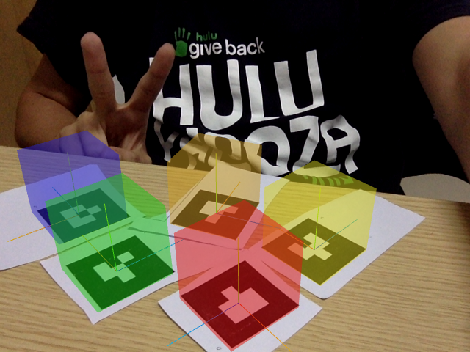
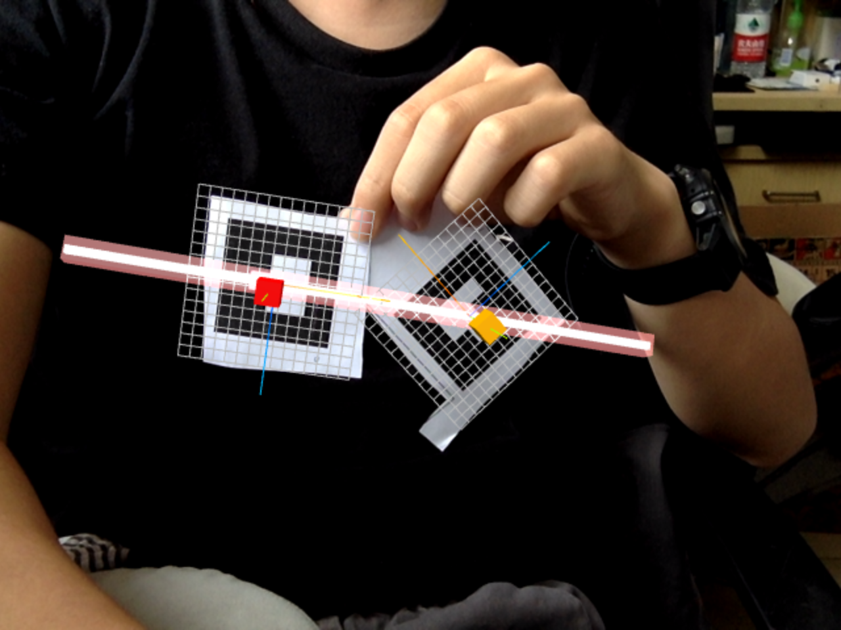
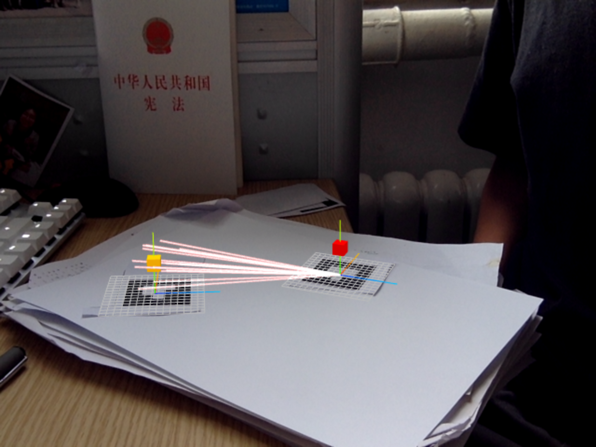
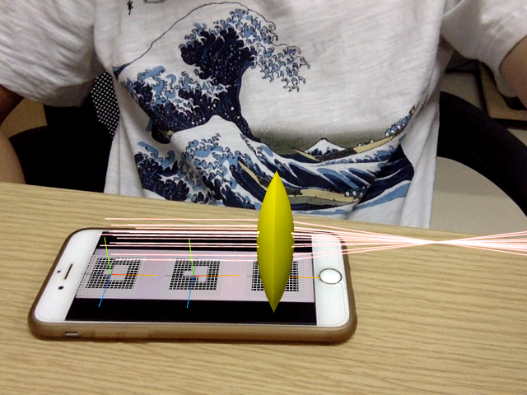
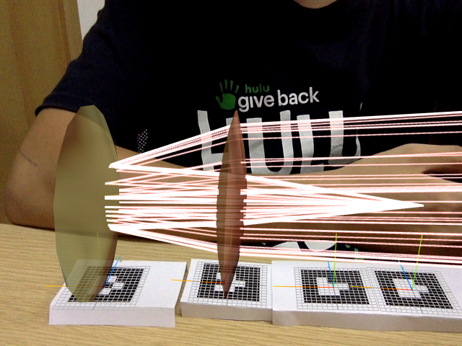
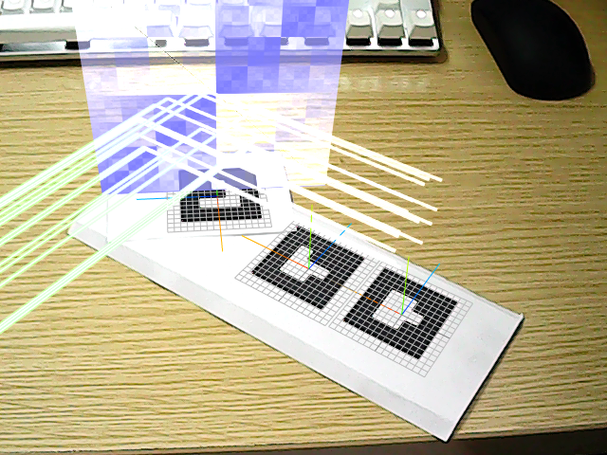
The two weeks of development
Notes:
From simple demo to complex application

Slide 25
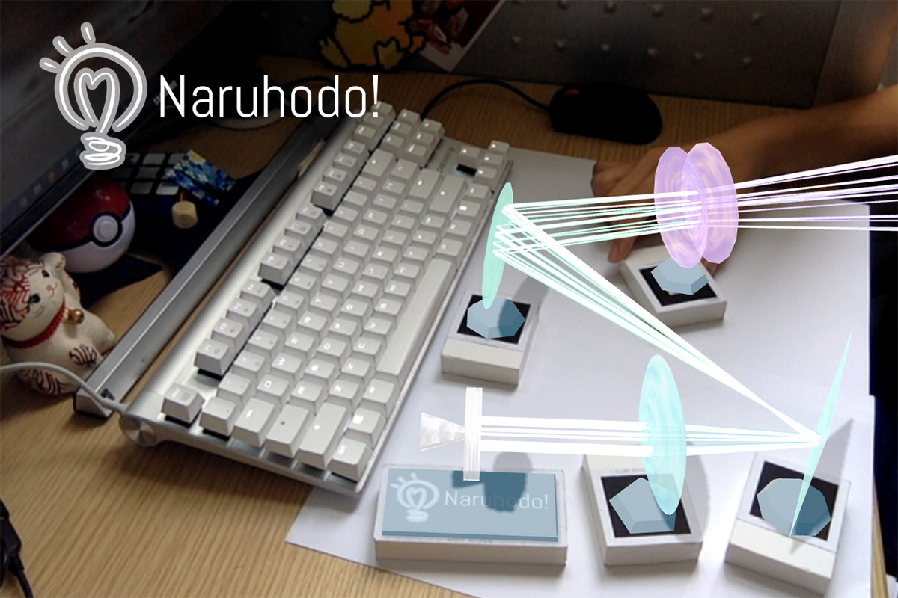
THANKS!
Designed & developed by Bowei Zhou
https://b-z.github.io/naruhodo

